Slide 1

Test your knowledge
What do you really know about water? Let’s find out!

Slide 2
Test your knowledge
What do you really know about water? Let’s find out!

Slide 3


True or false? Water can dissolve
more substances than any other
liquid, including sulfuric acid.
True
False
Well done!
Oops!

Slide 4
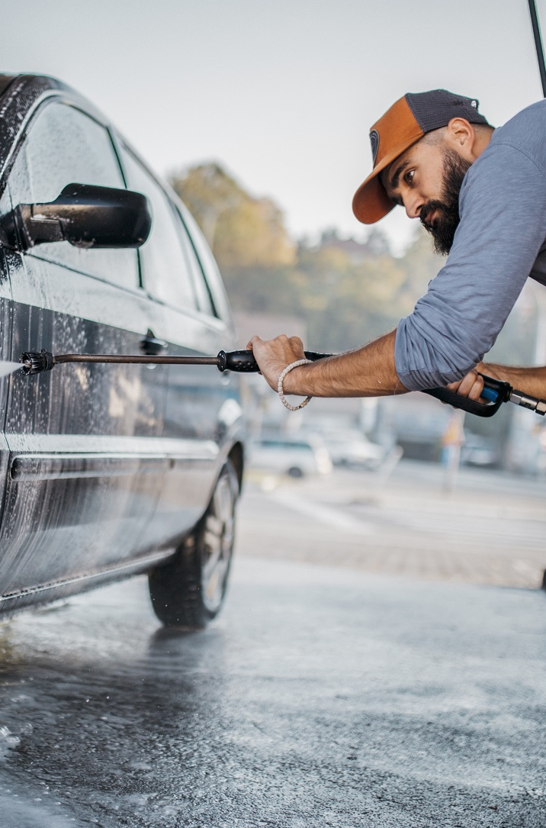
How much water does it
take to make a new car?
4,500 litres
177,000 litres
Oops!
Well done!
77,000 litres
250,000 litres
Oops!
Oops!

Slide 5
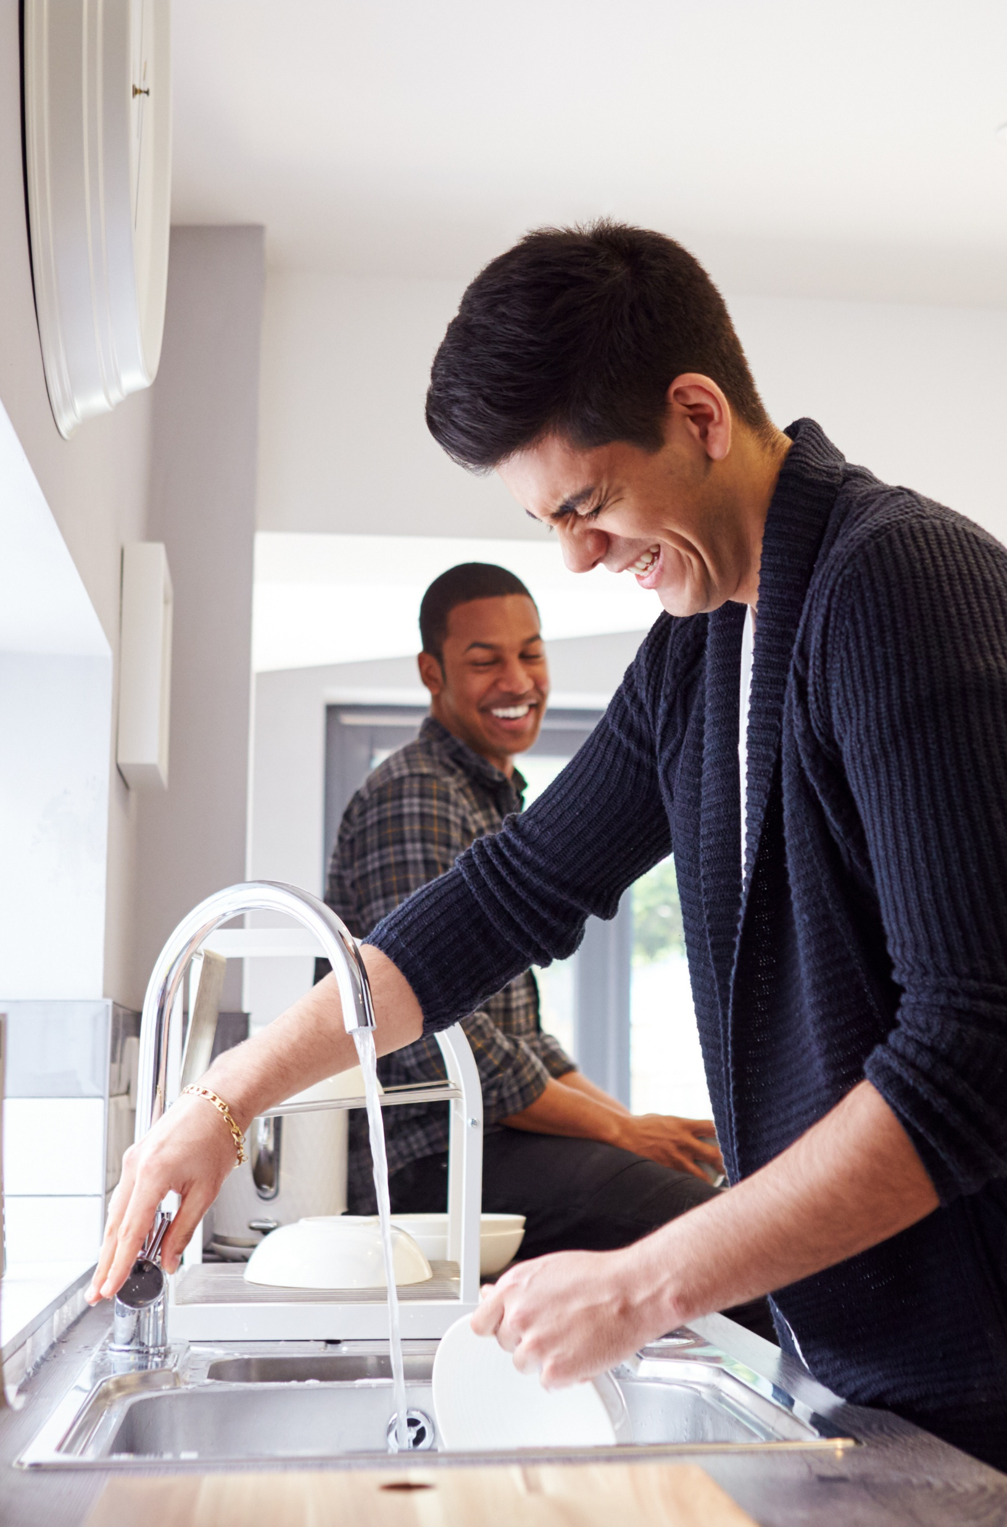
How much water can a dripping tap waste in a year?
500 litres
5 litres
Oops!
Oops!
5,000 litres
50,000 litres
Well done!
Oops!

Slide 6


On average, how much water does a leaky loo waste in a day?
200 litres
400 litres
Oops!
Well done!
600 litres
800 litres
Oops!
Oops!

Slide 7
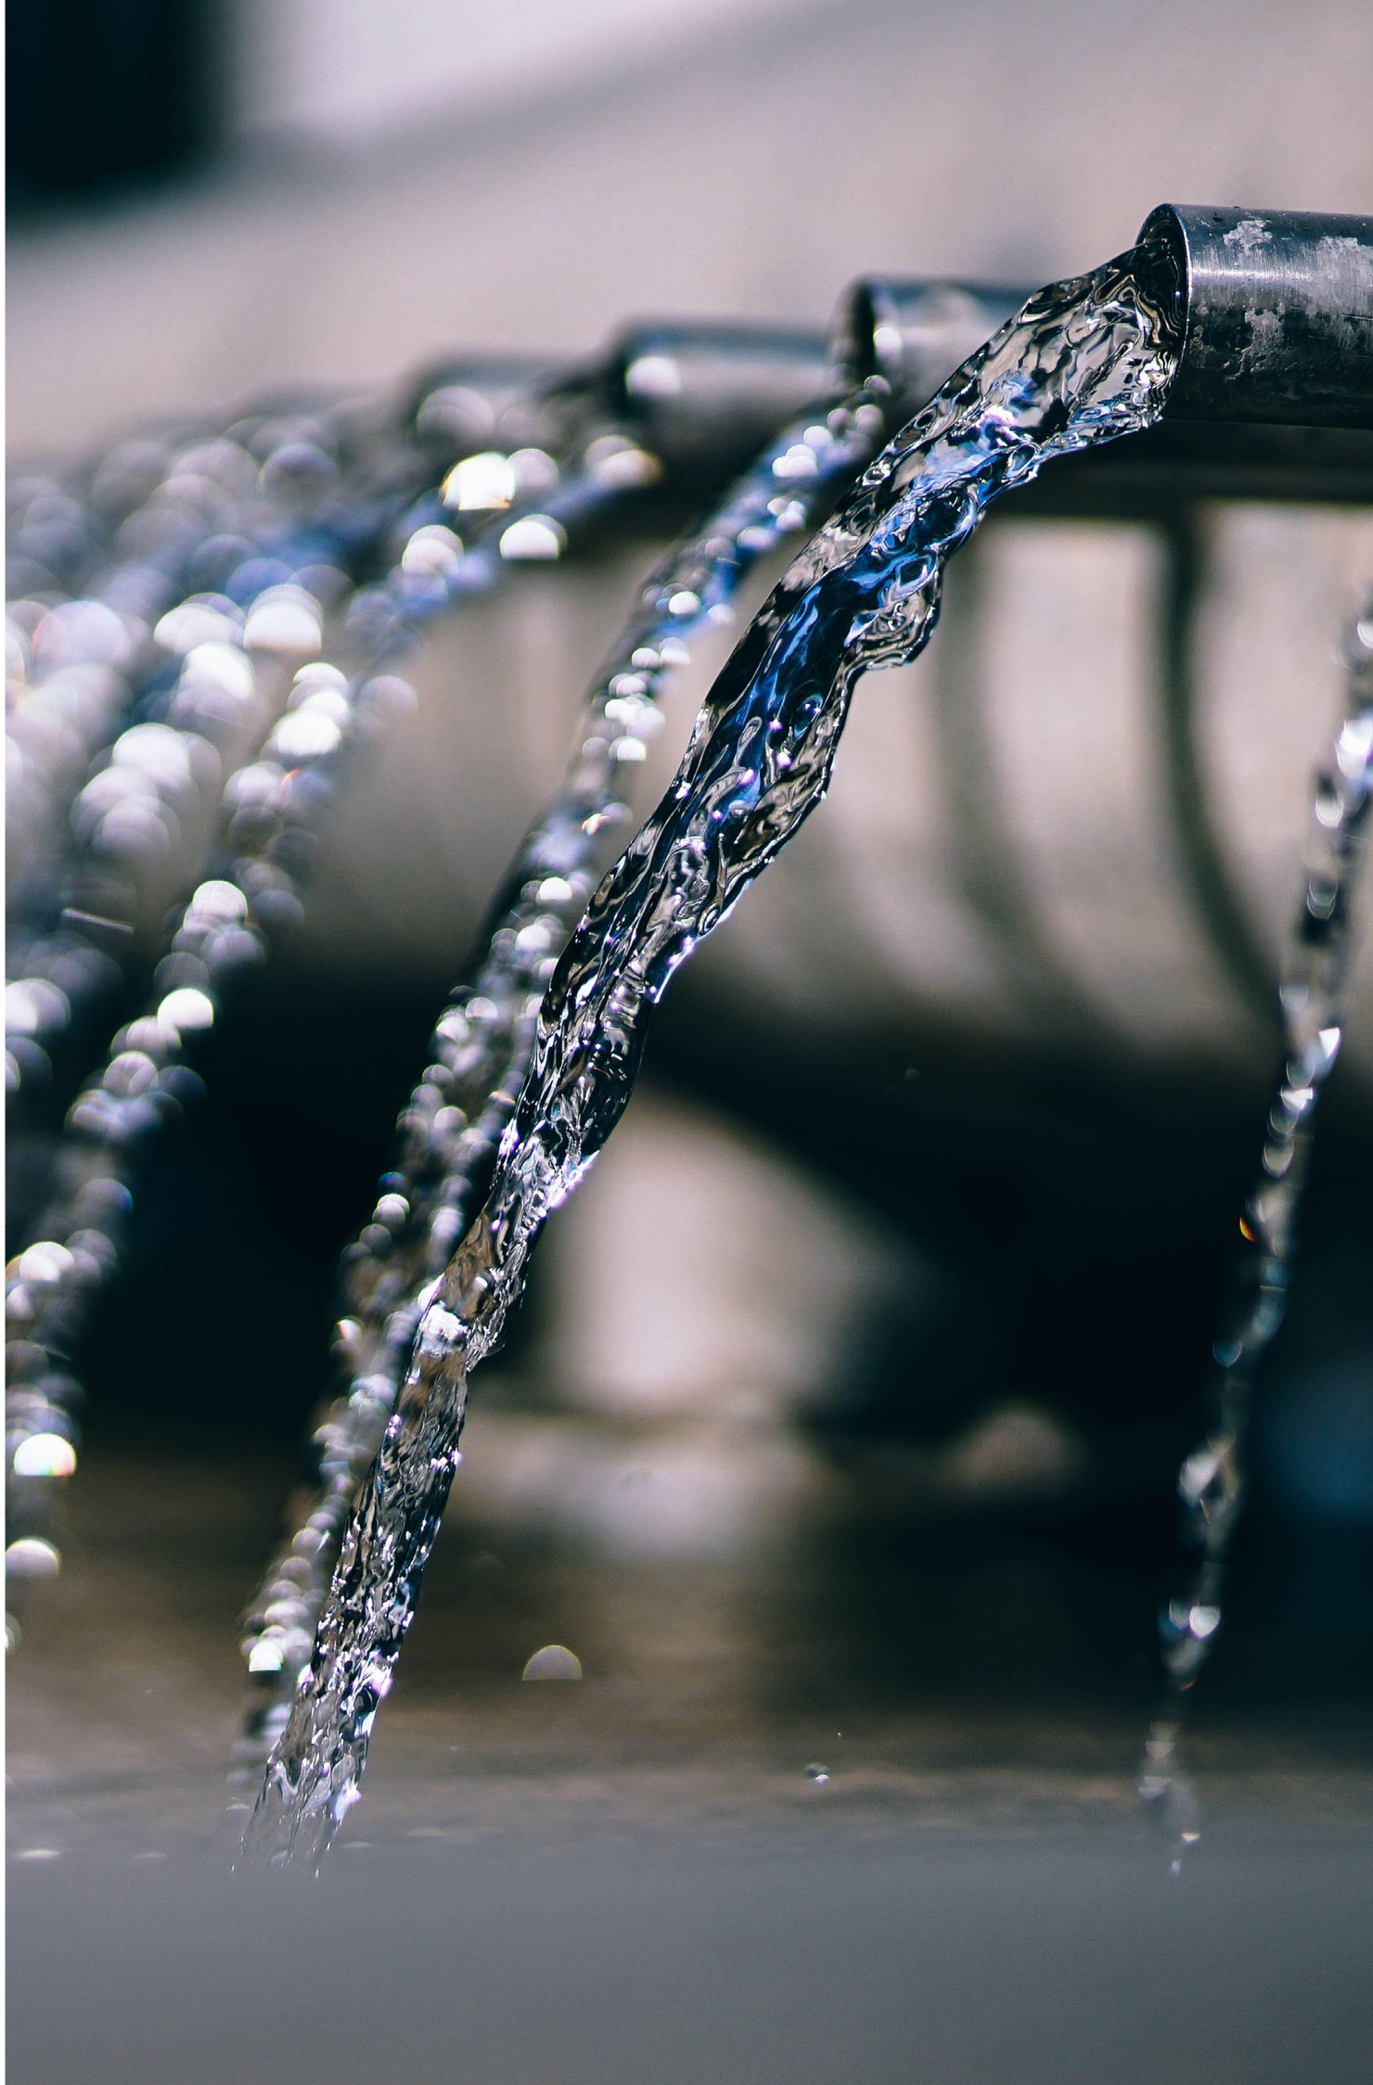
How much money is spent every year in the UK clearing fatbergs?
£100
£100 million
Oops!
Well done!
£100,000
£10,000
Oops!
Oops!

Slide 8
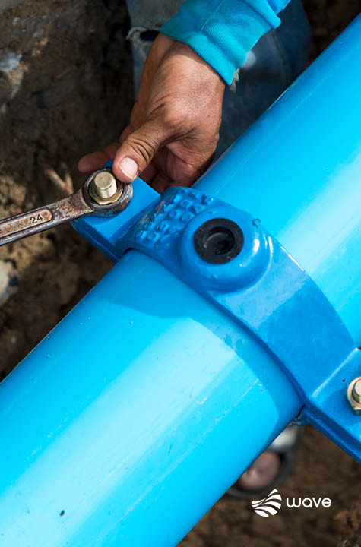
What percentage of sewer blockages
are caused by misusing toilets?
80%
95%
Well done!
Oops!
75%
50%
Oops!
Oops!

Slide 9
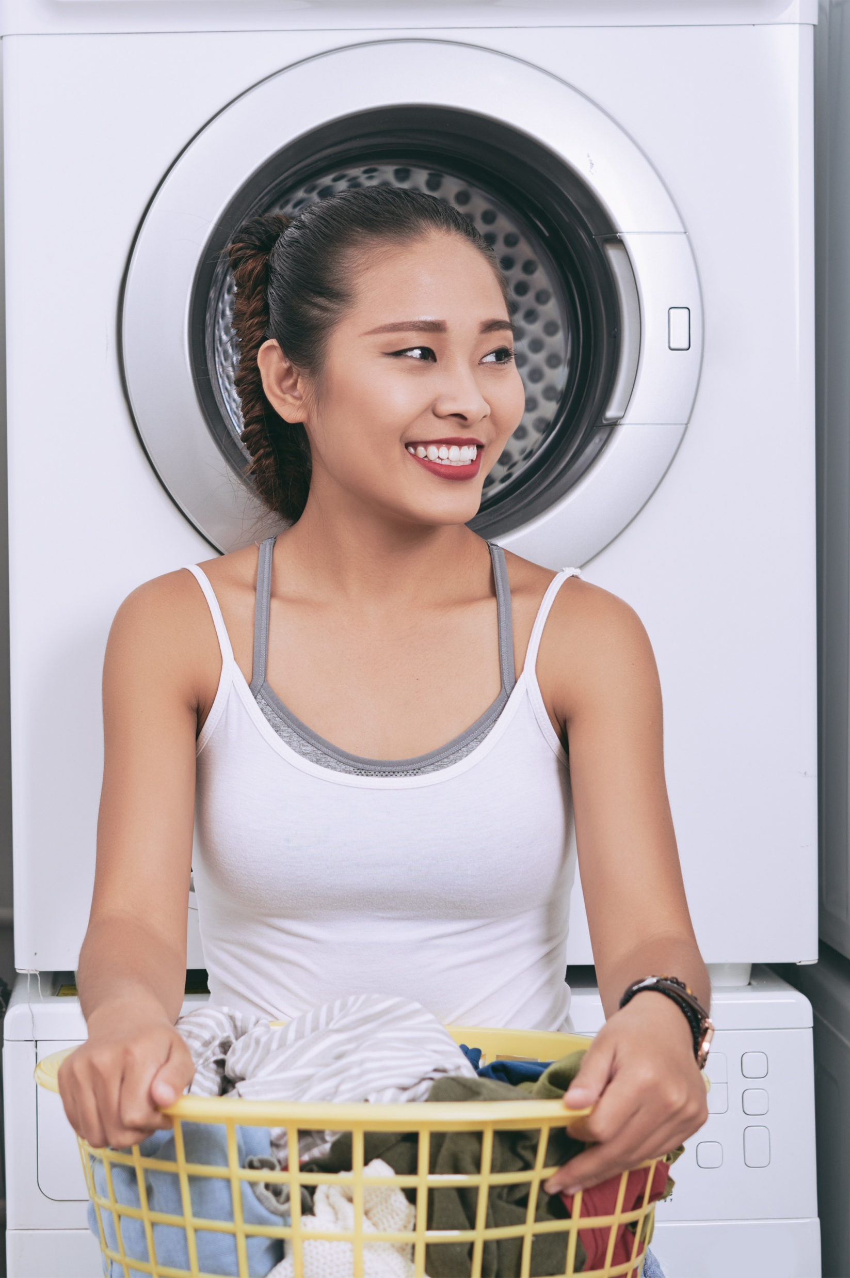
How much water does the average person use per day?
40 litres
5 litres
Oops!
Oops!
140 litres
1000 litres
Well done!
Oops!

Slide 10
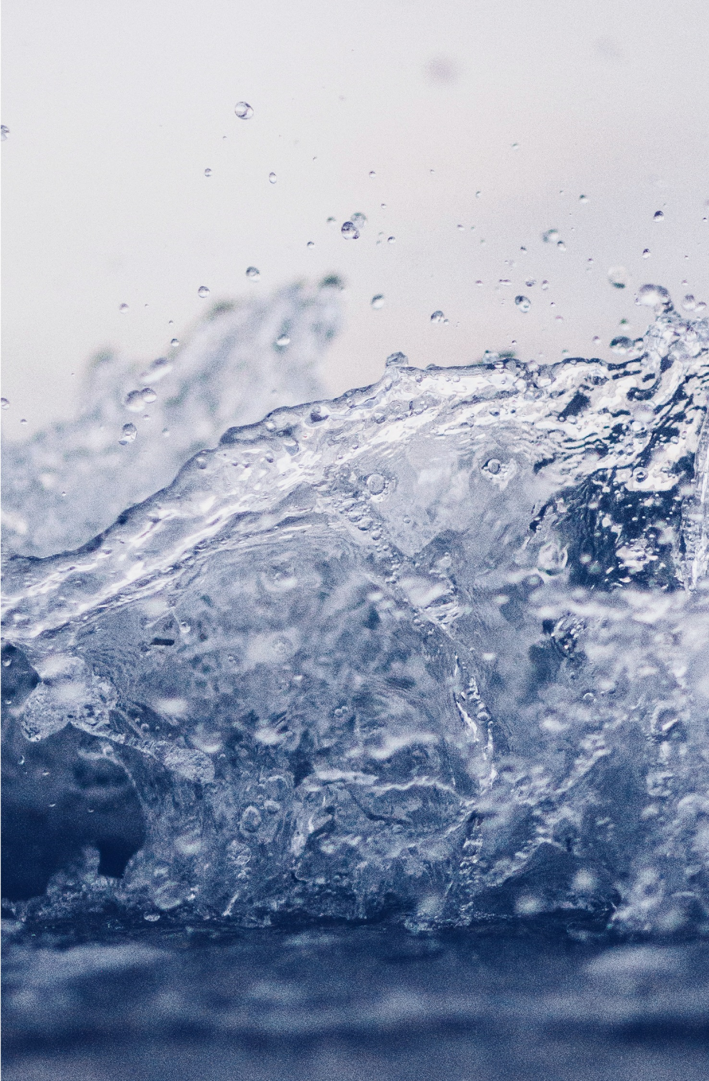
Which of the following are ok to be flushed down the toilet?
Wet wipes
Paper
Dental floss
Nappies
Kitchen roll
Poo
Pee
Cotton buds

Slide 11
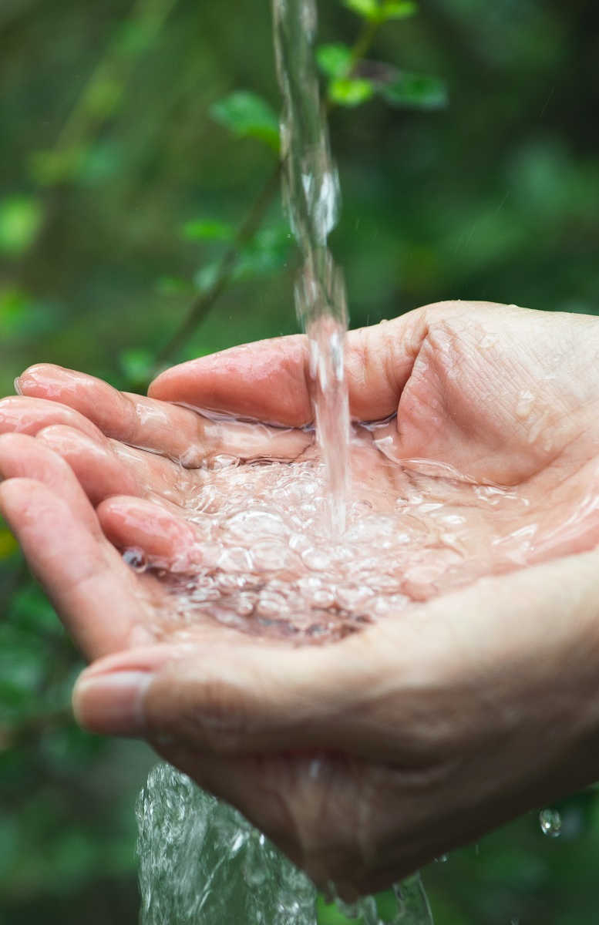
How much money do uncontrolled urinals waste per year, per urinal?
£300+
£900+
Oops!
Oops!
£500+
£700+
Oops!
Well done!

Slide 12
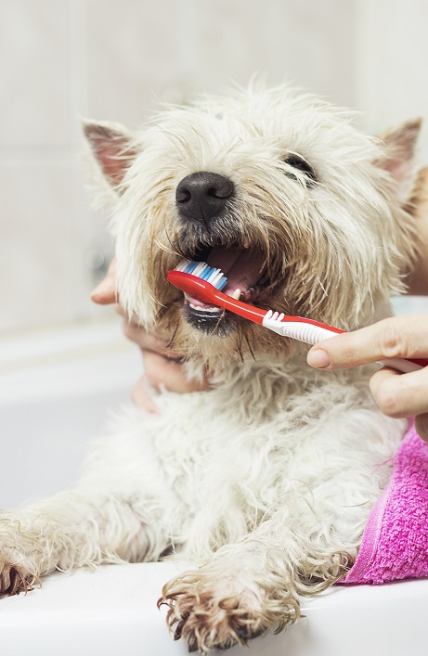
How much water could you save per minute by turning off the tap while brushing your teeth?
5 litres
10 litres
Oops!
Well done!
1 litre
100 litres
Oops!
Oops!

Slide 13

How did you do?

