Slide 1

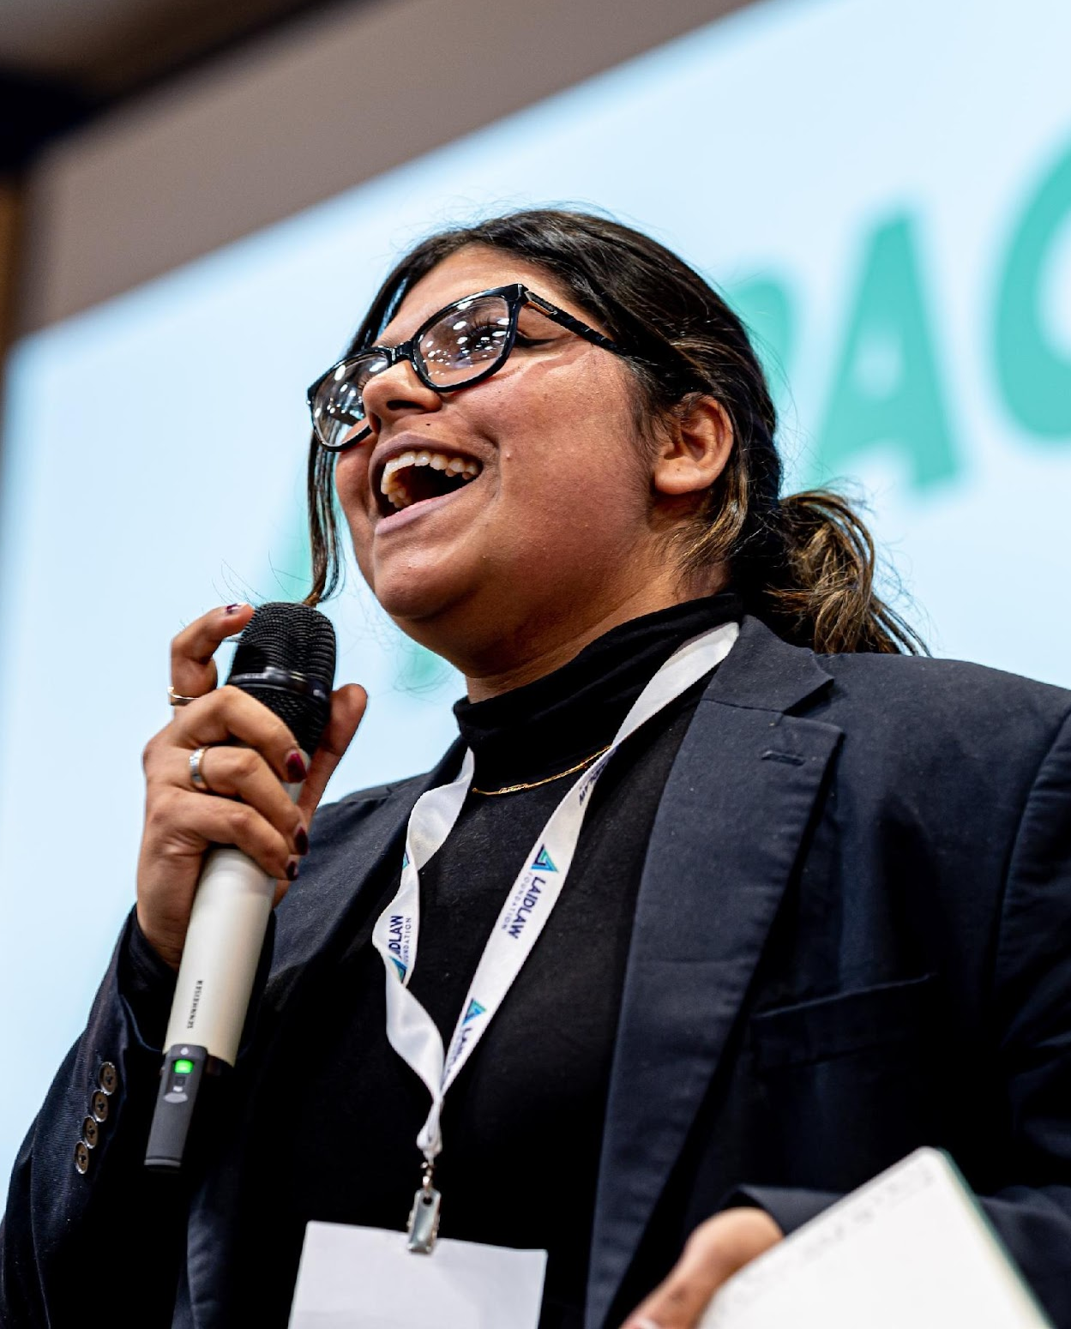




STUDENT INFORMATION SESSION
Laidlaw Scholars Leadership & Research Programme at Durham University.

Slide 2
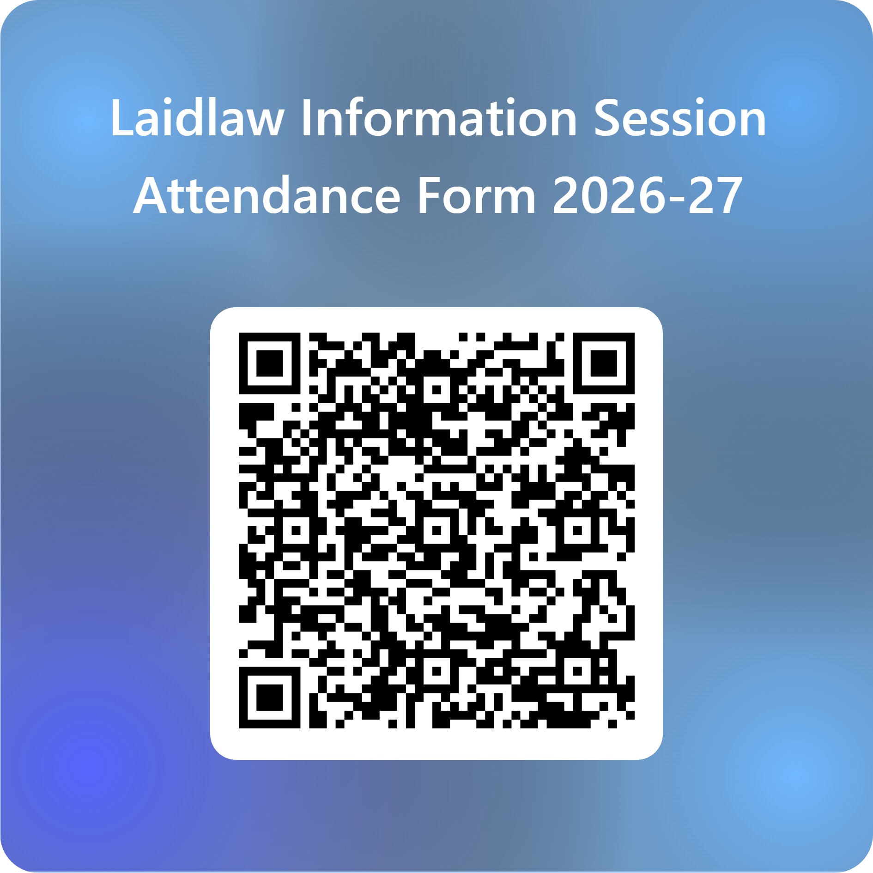
Information Session Registration
Welcome to the session! We're delighted to have you join us.
Whilst we introduce ourselves, please register yourself using the QR code on the right. We'll use this to send you this PowerPoint.

Slide 3

About the Programme
The Laidlaw Scholars Leadership & Research Programme invests in passionate undergraduate students to become ethical leaders in every sector and geography.
We believe good leaders come in all shapes and sizes, from every type of background: the quiet and the gregarious, the scientist and the poet, the musician and the athlete. Whatever your passion or previous experience – you have the potential to lead.

Slide 4
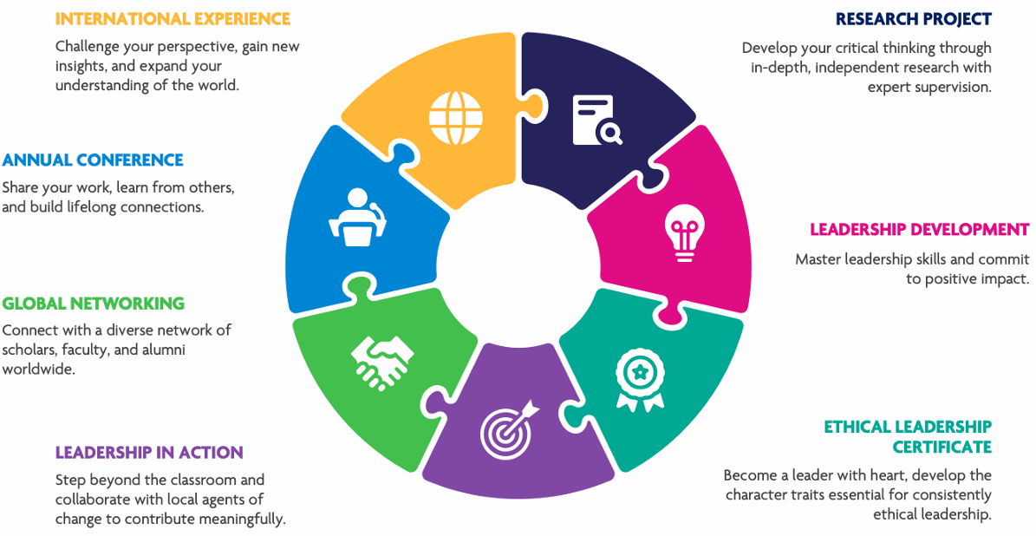
Holistic Development - Programme Elements

Slide 5
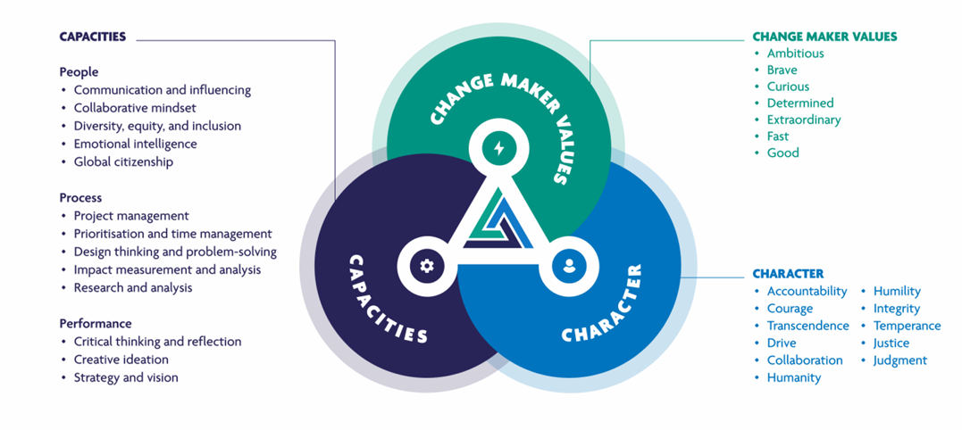
The Laidlaw 3C’s

Slide 6





















World Leading Partners
As of 2025, the Laidlaw Scholars Leadership & Research Programme is hosted by 21 prestigious universities worldwide, known for their commitment to research excellence and developing future leaders.

Slide 7

About the Laidlaw Foundation
The Laidlaw Foundation is a global non-profit dedicated to enriching lives through the transformative power of education, particularly focusing on individuals from underserved communities. Their initiatives span from nurseries to C-Suites across six continents, cultivating a diverse community dedicated to creating equitable opportunities.
They are committed to developing leaders who embody excellence, act with integrity, and who are driven to solve the world’s most intractable problems.

Slide 8
Leadership Training

Slide 9

Personalised Leadership Development Training
Over the 20-month programme, Laidlaw Scholars receive personalised leadership development training designed to build their unique skills in individual, team, and situational leadership. These sessions will often involve collaborative working sessions

Slide 10

Ethical Leadership Certification
Develop your character and learn to lead with integrity by earning a certification in ethical leadership from the Oxford Character Project.
This certification is designed to prepare you to make values-based decisions and lead ethically in any field. Training and case studies are provided as part of the certificate
This is a mandatory component of the programme

Slide 11
First Summer: Research Project

Slide 12

An Independent Research Project
During the first summer, Laidlaw Scholars undertake an independent 6-week research project under the guidance of a leading university academic. You can choose a topic from a list provided by your university or propose your own topic, given you have academic supervision confirmed.
At the end of your research, you will produce a 3000-word research paper and a poster summarising your findings and demonstrating your ability to conduct rigorous, impactful research.
The poster will be entered in a competition run by Taylor and Francis with the chance to have your work published in an academic journal

Slide 13

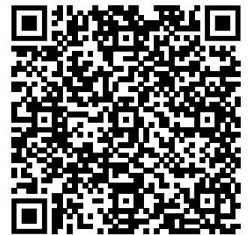
Past Scholar Experience
Mairéad Graham
Project: How can the UK's asylum system be reformed to be more compassionate and efficient?

Slide 14

Examples of Past Research Projects
Scan the QR code to view research projects on the Laidlaw Scholars Network, or go to: https://laidlawscholars.network/channels/2092-research

Slide 15
Second Summer: Leadership in Action Experience

Slide 16
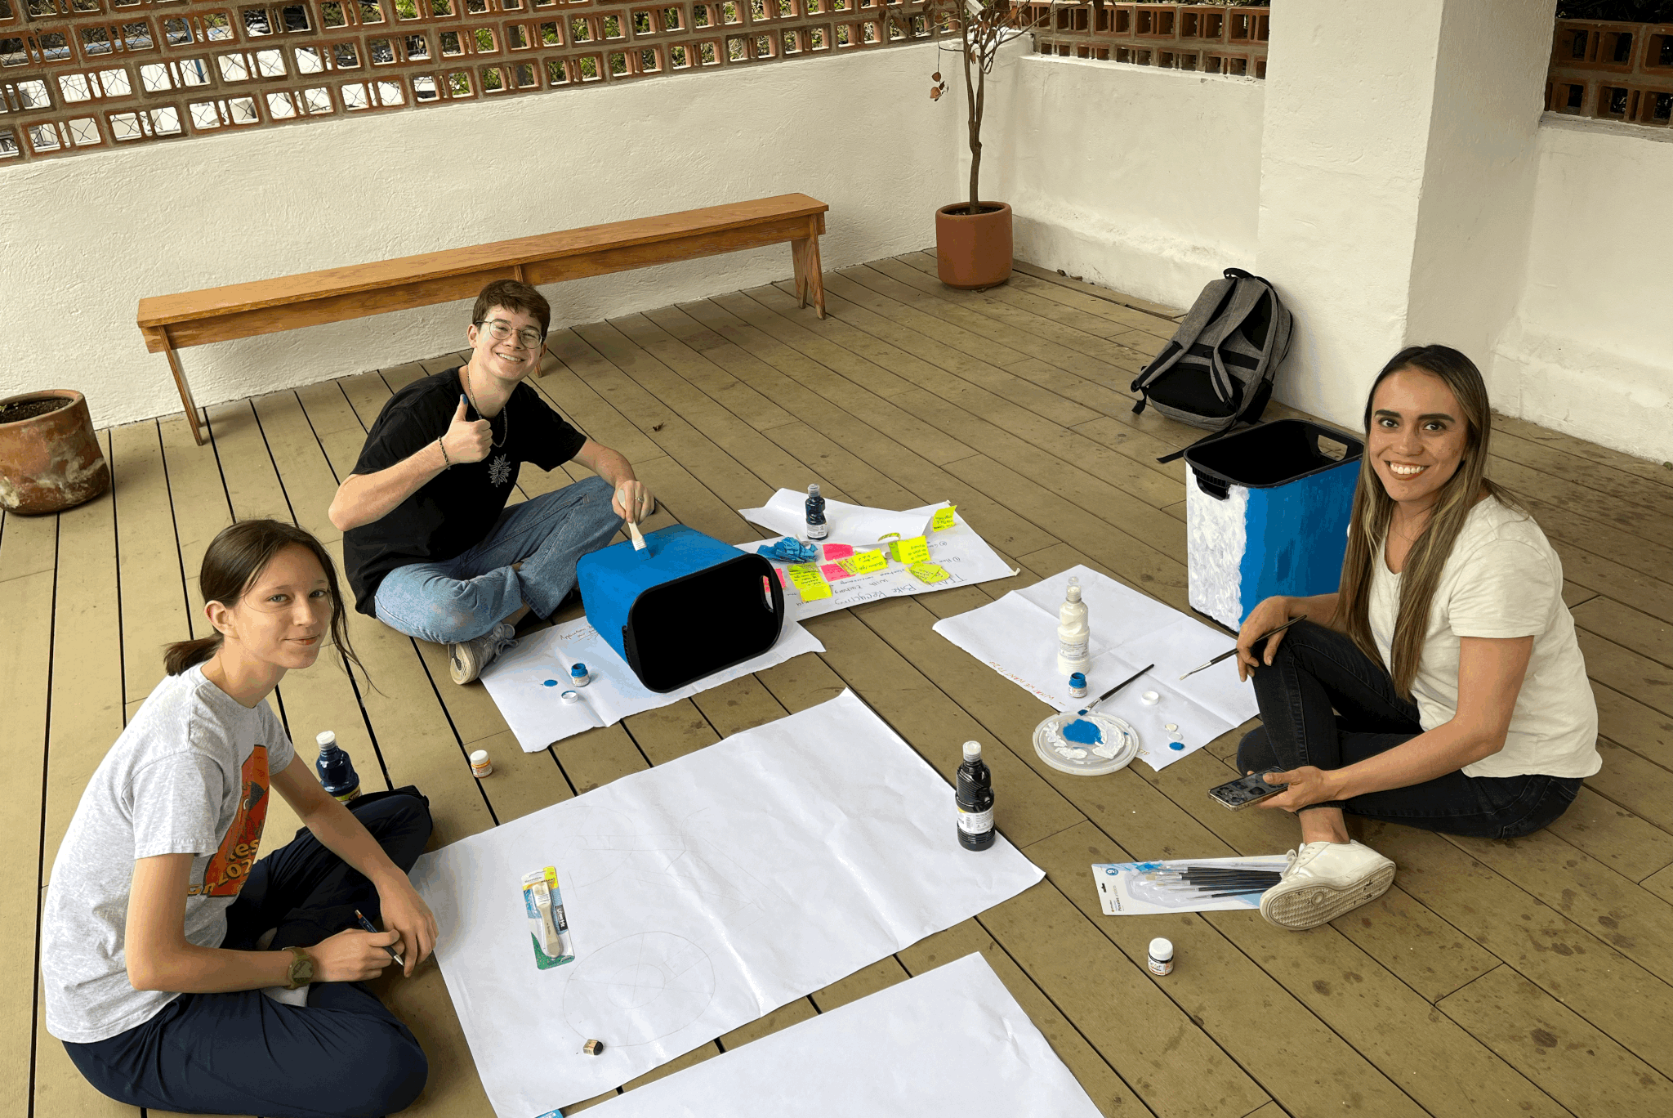
International Leadership in Action
Put your leadership into practice through a 6-week immersive project, designed to create meaningful, ethical, and sustainable impact.
Your Leadership in Action (LIA) project is a chance to step beyond the classroom and work in partnership with local agents of change.
You will co-design and deliver a real-world initiative that advances the UN Sustainable Development Goals, challenges your comfort zone, and deepens your leadership learning through action and reflection.
https://sdgs.un.org/goals

Slide 17
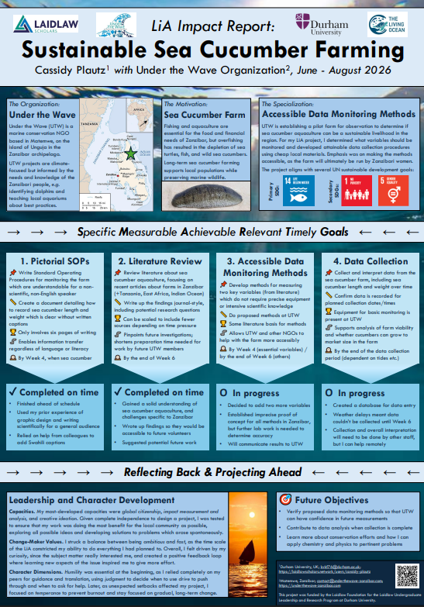
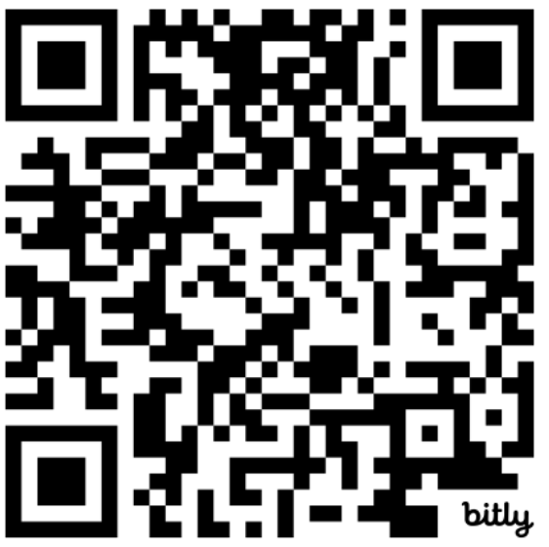
Past Scholar Experience
Cassidy Plautz
Sustainable Sea Cucumber Farming

Slide 18

Examples of Past Leadership in Action Projects
Scan the QR code to view Leadership in Action projects on the Laidlaw Scholars Network, or go to:
https://laidlawscholars.network/channels/2061-leadership

Slide 19
International Experience

Slide 20

Meaningful International Experience
Every Laidlaw Scholar is expected to engage in an enriching international experience, which can be customised to fit your personal interests and goals:
Research Project: Conduct your research in an international context, addressing questions that span cultures and countries.
Leadership in Action Project: Participate in a project abroad that allows you to immerse yourself in a new community, creating tangible impact while broadening your perspective.

Slide 21
Global Community

Slide 22
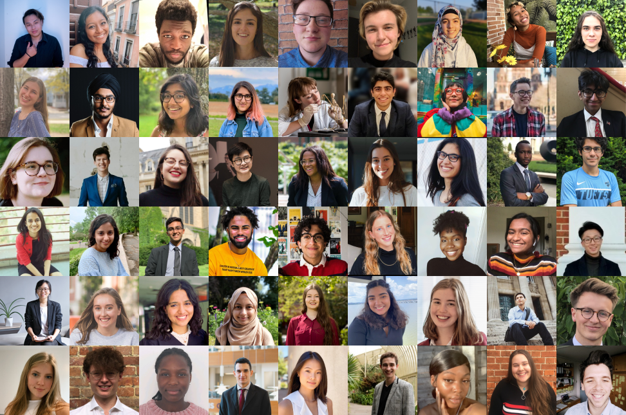
Global Community
Join a vibrant global network of over 2,500 Laidlaw Scholars. Our online platform, the Laidlaw Scholars Network, enables you to share research, exchange ideas, collaborate on impactful projects, and build lifelong connections. Continue developing your leadership skills while being part of a supportive and inspiring community.

Slide 23
Scholars Conference

Slide 24

Annual Laidlaw Scholars Conference
The Laidlaw Scholars Annual Conference is a unique opportunity to connect with a global community of passionate change-makers. Held annually, usually in October or November, this fully-funded weekend features inspiring keynote speakers, interactive workshops, and opportunities to present your projects. Network with peers from diverse backgrounds, learn from experts in various fields, and gain valuable experiences that will drive your leadership journey forward.

Slide 25
How to Apply

Slide 26
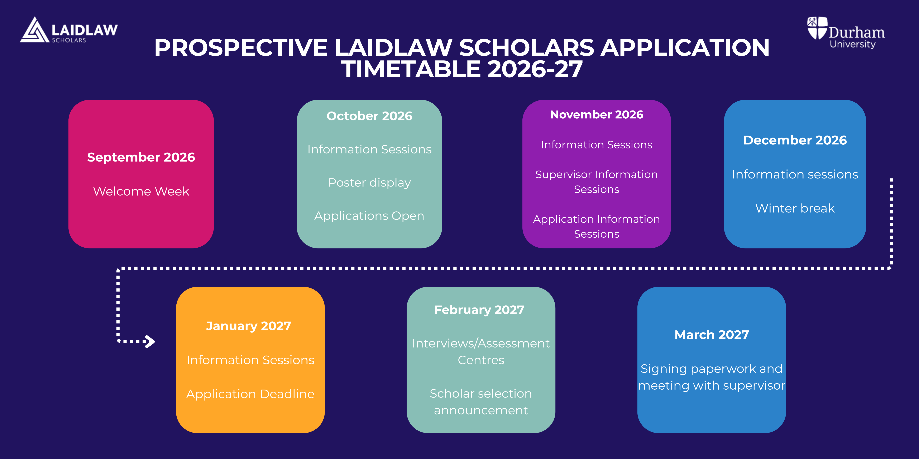

Slide 27
How to Apply
Applications will open on the 1st of October and will close on 30th January. The link to the Microsoft Form facilitating applications will be made available on our website.
Here are some top tips for building your application:
We are looking for someone who can engage equally in all key aspects of the programme (Research and Leadership)
We want to see motivation for students to enhance their leadership skills, develop character, work collectively as a Laidlaw cohort engaging in social activities and global networks
Research the Laidlaw Leadership and Research Programme – develop knowledge of how the programme would be useful to your development as a leader.
Ensure your personality comes through in your application. We especially appreciate your own stories and insights.
Demonstrate your desire to work with communities in need
Reach out to current Laidlaw scholars and alumni via the Laidlaw Scholars Network and LinkedIn. They may be able to offer advice on putting together an application, as well as what the Scholarship is about.
Employ the STAR method when responding to application prompts – this makes your application/interviewing dialogue more compelling.
Make sure that you understand the United Nations Sustainable Development Goals
      - https://sdgs.un.org/goals

Slide 28
How to Apply II
You may also want to consider whether you'd like to self-define a research project or collaborate with a Durham University professor as part of a pre-defined project. The list of pre-defined projects will be available on our applications page.
We will be running workshops to support you in writing project proposals, including in self-defining – further information about these are available on our website.

Slide 29
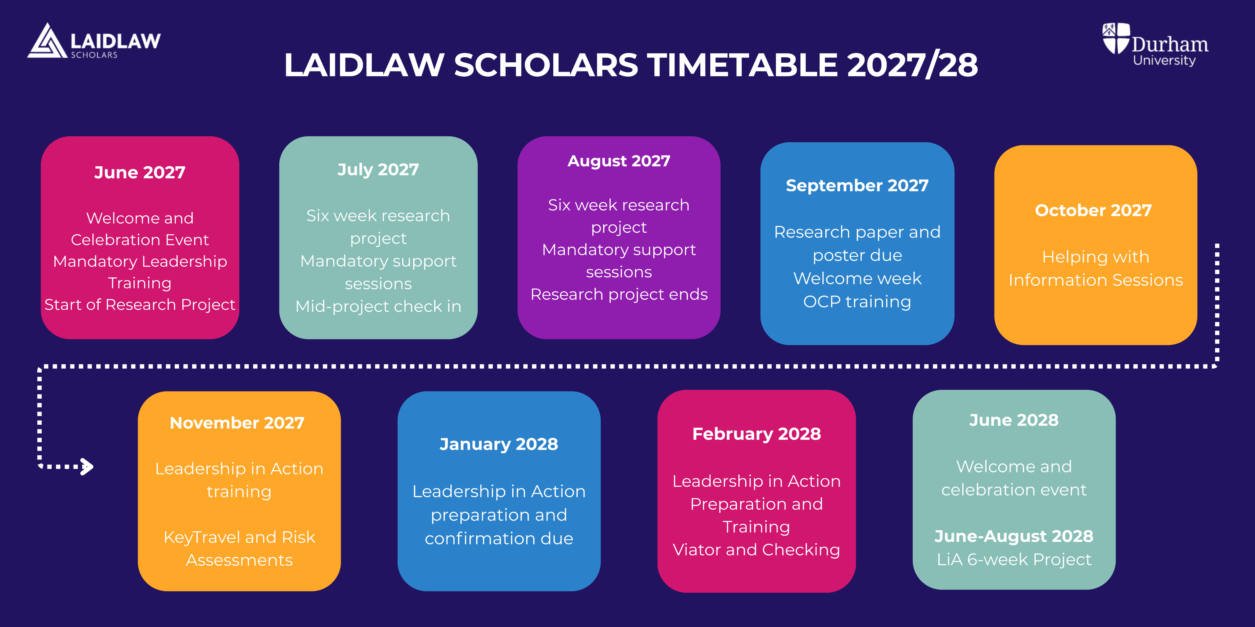

Slide 30
Programme Timelines (compulsory components): Year One
Dates and Timeline:
Welcome and Celebration event: June
Leadership Development: June
First Oxford Character Project session
Research Project: end of June – first week of August
Research Report and Poster deadline: Beginning of September
Required Outputs:
Pre/Mid/Final reflection of Leadership Training on Laidlaw Scholars Network
Meet with supervisor 6 times during research period
Three reflections on Laidlaw Scholars Network during research period
3000-5000 word Research Paper
Research Poster
Attendance at initial Oxford Character Project workshop and 6 OCP case study workshops
Specific dates are available on the Laidlaw website and on the scholar’s timeline document
https://www.durham.ac.uk/colleges-and-student-experience/enrichment-activities/laidlaw-programme/

Slide 31
Programme Timelines (compulsory components): Year Two
Dates and Timeline
Leadership in Action: 6 weeks between end of June- end of August
Recruitment for incoming cohort
Attend the 2028 Welcome and Celebration event
Required Outputs
Attend LiA training (KeyTravel, Risk Assessment and Viator)
Complete the requirements of Safeguarding policy/Supervisors/Requirements of the LiA chosen NGO
Weekly reflections posted on the Laidlaw Network linked to Laidlaw values, and 3 C’s
Final LiA reflection posted on Laidlaw Scholars Network
An A1 Poster documenting LiA experience
Help recruit incoming cohort of scholars
Act as mentors and ambassadors to new scholar cohort
Specific dates are available on the Laidlaw website and on the scholar’s timeline document
https://www.durham.ac.uk/colleges-and-student-experience/enrichment-activities/laidlaw-programme/

Slide 32

Use this QR code to view the dates for the incoming cohort
2026-2027-2028 Timetable

Slide 33
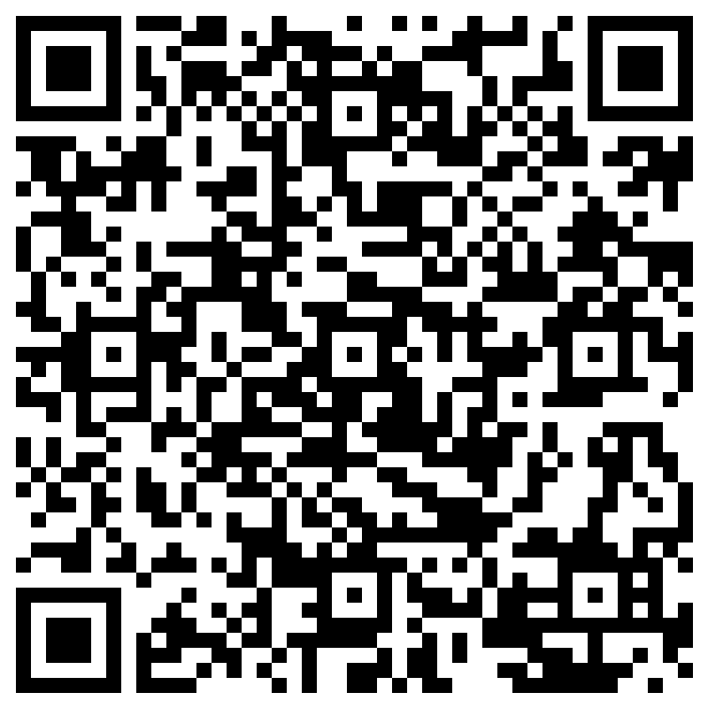
Research Proposal Writing Workshop
Scan the QR Code to Register Now and get personalised support with your Laidlaw Application!

Slide 34
Required Outputs
Research Outputs:
One Research Paper 3000-5000 words
An A1 Research Poster to be presented at the European conference
x3 posts on the Laidlaw Scholars Network during your research period
Leadership in Action Project:
Outline of Project and Summary of goals
Required weekly reflection post on the Laidlaw Scholars Network
Leadership in Action Reflection Blog/Vlog
Ethical Leadership and Global Citizenship Reflection

Slide 35
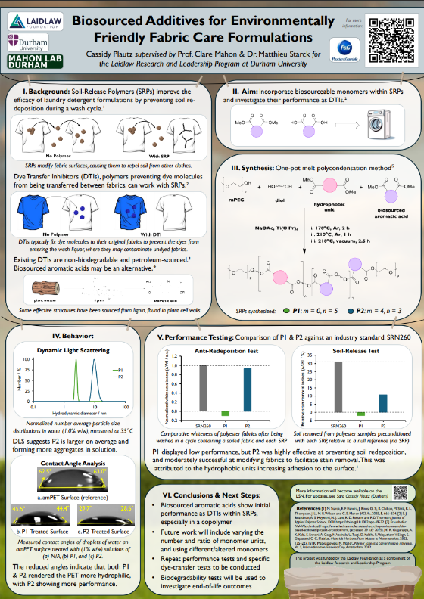
Durham Student Experiences
Summi Ng
Alexander Belay
Matthew Lim
Cassidy Plautz
Research poster created by Cassidy

Slide 36
Questions?
For any questions, please email:
laidlaw.scholarships@durham.ac.uk

Slide 37



  HOW DO I DESIGN A PROJECT AND FIND A SUPERVISOR?

Slide 38
  Designing a Project...

Slide 39




How do I Design a Project?
  Food for thought...
What do you enjoy learning more about?
What global issues spark your interest?
Which of the UN SDGs are you passionate about?
What would you like to do in the future? Can you relate you project to this?

Slide 40

What Makes a Good Research Project?
  The Laidlaw Scholars Programme is designed to make a real-world impact
  Find a project which works to target a significant global issue
  The Laidlaw Foundation encourages projects which focus on one or more of the UN’s Sustainable Development Goals

Slide 41
  Finding a Supervisor...

Slide 42
  What is the Role of Your Supervisor?
  Review research proposals and endorse their viability, academic rigour and integrity
  Work with you to finalise your research outline and project plan
  Meet regularly with you to review progress over the six weeks and ensure an academically robust research outcome
  Review, edit as needed, and endorse your final research poster/paper
  Ensure that you post your research findings on the Laidlaw Scholars Network
  Help you find conferences to attend and publications, as appropriate, where you can share your research findings.

Slide 43
  Steps to Take When Finding a Supervisor...
  Sometimes, finding a supervisor who has the time and expertise to work with you takes time
Speak to your academic advisor
Email your course director or department Head of Education
Speak to your college principal
  It is important to remember your supervisor doesn’t necessarily need to specialise in the area of your research as long as they are passionate about helping you

Slide 44
Frequently Asked Questions

Slide 45
How time-intensive is the programme?
• During term time: manageable alongside your degree
• During summer research: full-time commitment for 6 weeks
• Leadership in Action (LiA): planned flexibly during your second year
The programme is designed to be demanding but realistic for undergraduate students.

Slide 46
What support will I receive?
• Academic supervision during the research project
• Leadership training and skills workshops
• Ongoing support from the Laidlaw team
• Access to current scholars and alumni
You are not expected to do everything independently

Slide 47
Who can apply?
• Students from all academic disciplines who are either: in Year 1 of undergraduate study, or in Year 2 of a four-year undergraduate degree
• Students in Year 2 of three-year undergraduate programmes are not eligible
• No previous research or leadership experience is required
• Motivation, curiosity, and commitment are more important than a “perfect” CV

Slide 48
What if my plans change?
• Research topics can be refined after selection
• LiA plans can evolve over time
• Support is available if challenges arise Flexibility is part of the programme

Slide 49
Do I have to be in Durham for the Research period in Summer One?
Yes.
You must be in Durham for the specified period
If you have extraordinary circumstances that will prevent you being in Durham, please discuss this with the Laidlaw manager

Slide 50
What does an ‘international experience’ mean for international students?
If you are an international student who normally lives outside the UK but studies at Durham, completing your Leadership in Action (LiA) project in Durham will still be considered an international experience.

Slide 51
Do both my research project and my LiA need to be international?
No. Only the Leadership in Action (LiA) project must involve an international experience, which takes place during your second year.
Your research project does not need to be international.

Slide 52
Do I need to fully design my LiA project at the application stage?
No. At this stage, you only need to answer the two LiA-related questions in the application form.
You are not expected to have a fully developed LiA project yet.

Slide 53
The character count in the application form has changed — is this correct?
Yes.
The current character count is correct. An earlier version had a lower limit, which has now been updated to allow more detailed responses.

Slide 54
Do I need a reference or supervisor support?
• Pre-defined projects: require an academic reference This should be provided by a Durham academic who is familiar with your academic work, such as a lecturer, tutor. This cannot be a PhD student
• Self-defined projects: require a statement of academic support from the supervisor who will support you during the 6-week research period Require a statement of academic support from the academic supervisor who has agreed to support you during the 6-week summer research period.

Slide 55
Can I have a PhD student as a supervisor
No.
If you are being supported by a PhD student, you will need to have an academic as your main supervisor
But you can still have multiple sources of support including postgraduate students

Slide 56
Do I need to know exactly what my LiA project will be when applying?
No. You do not need a finalised LiA project.
However, when applying, you should:
• research examples of past LiA projects or centrally organised options
• clearly explain why you want to take part in the LiA component Your plans may change later, and this is completely normal.

Slide 57
Do I always need to do a literature review?
Yes.
A literature review is a core part of any research project.
The reading you do while preparing your application can be reused later, but you will also need to continue engaging with academic literature during the research period and in your final paper.

Slide 58
When does the international experience take place?
The international experience takes place during the Leadership in Action (LiA) component in the second year of the programme. LiA typically involves an international project or placement, which is usually undertaken during the summer, following planning and approvals earlier in the year

Slide 59
What is the difference between the summer research project and the Leadership in Action (LiA) project?
The summer research project takes place in the first year of the programme and focuses on academic research under the supervision of a Durham academic. The Leadership in Action (LiA) project takes place in the second year and focuses on applying leadership skills in practice through an international project or placement, often working with partner organisations or communities.

Slide 60
Is the Research project compulsory and can I split it into sections?
Yes.
The Research project is a compulsory component of the Laidlaw Leadership & Research Programme and is required in order to complete the programme.
No.
You must complete it in one 6-week block not sections

Slide 61
Is the Leadership in Action (LiA) project compulsory and can I split it into sections?
Yes.
The Leadership in Action (LiA) project is a compulsory component of the Laidlaw Leadership & Research Programme and is required in order to complete the programme.
No.
You must complete it in one 6-week block not sections

Slide 62
Is the programme funded?
Yes. The programme is funded and provides generous financial support in both years.
Scholars receive a stipend of £3,000 in Year 1 to support living costs during the summer research period.
In Year 2, scholars receive further financial support of up to £3,000 to support costs associated with the Leadership in Action (LiA) component, including living expenses during the international experience. Across the programme, this represents up to £6,000 in total financial support, intended to help cover essential costs such as accommodation, food, and related expenses while participating in programme activities.
Please note that specific arrangements and eligible expenses are subject to approval and guidance provided by the programme team.

Slide 63
Information Session Registration
Thank you for coming to the session!
Before you leave, please register yourself using the QR code on the right. We'll use this to send you this PowerPoint.

